Slide 1

PROJECT 2
Predicting house sale prices using regression models
Zhi Yuan, Yu Kiat, Kimberly,
Hang Feng, Yong Gui
Notes:
Good morning everyone. We’re group 4, these are my teammates and we will be presenting Project 2 in this order.

Slide 2


Problem Statement
Home Flipping Business
Notes:
So who are we and what do we do? We are a team of data analyst working for Livable that is in the home flipping business. So home flipping is basically taking an undervalued home, renovate it to increase its value, and sell it to make a profit. Our team’s goal is to use housing data collected between 2006 to 2010 to build a machine learning model that best predicts the potential sale price for properties located in Ames, Iowa.
By accurately predicting housing prices, we can better identify houses that are undervalued and the features to focus on renovation and repair works.
Is it clear what the student plans to do?
What type of model will be developed?
How will success be evaluated?
Is the scope of the project appropriate?
Is it clear who cares about this or why this is important to investigate?
Does the student consider the audience and the primary and secondary stakeholders?
We are a team of data analyst working for that is in the residential home flipping business. The team’s goal is to use housing data collected from 2006 to 2010 to build a Linear Regression model that best predicts the potential sale price for properties located in Ames, Iowa.
By accurately predicting housing prices we can better identify houses that are undervalued and the features to focus on renovation/repair works.

Slide 3
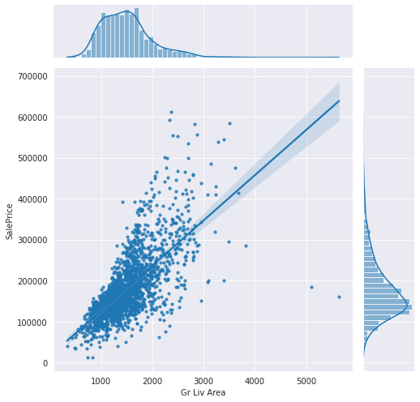
Living Area
Living area has a linear relationship with house price.
Notes:
And now, we move on to explore the data we have collected. The first feature is the living area, and we can see that it has a linear relationship with sale price. In the scatter plot below, we can clearly see that are some outliers, especially the two houses that is circled with living area greater than 5000 sq ft and price lower than $200,000.

Slide 4
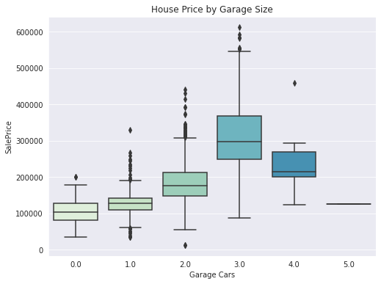
Garage Cars
Sale Price
Garage that can hold 4 cars or more
Garage that can hold 3 cars or less
<
Notes:
The 2nd feature is the number of cars that the garage can hold and how it relates to sale price. Interestingly, As you can see from the plot, as the number of cars the garage can hold increases, the sale price also increases up till 3 garage cars. After that, the sale price starts to drop off. The majority of the houses with garages that can hold 3 Cars and below sell between $100,000 to $550,000, while those that can hold 4 or more cars sell between $120,000 to $300,000.

Slide 5
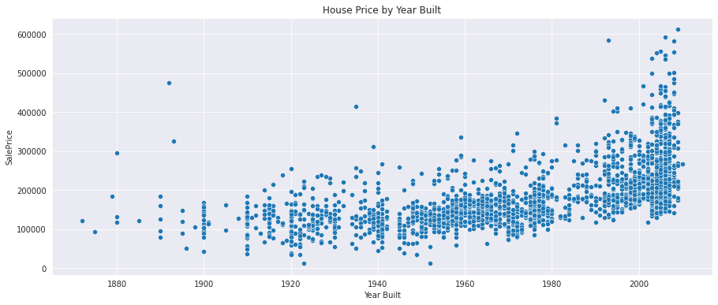
Year Built
The age of the house plays an important role in its price. There are several houses built before 1900 having a high price.
Notes:
The 3rd feature is which year the house was built. The age of the house plays an important role in its price. Newer houses tend to have higher average prices. As we can see in the graph, there is an uptrend in the sale price of houses built over the past 30 years. However, there are a few houses built before 1900 having a high price, circled in black.

Slide 6
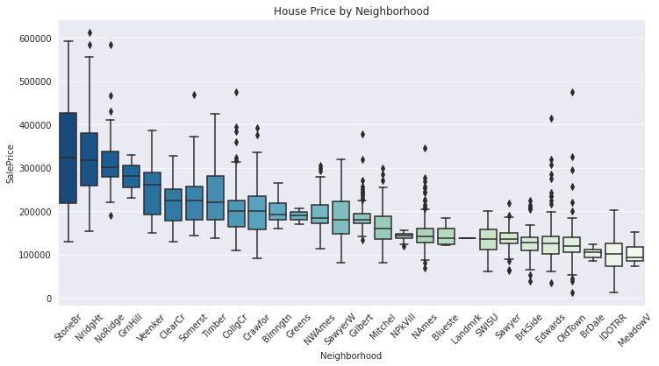
Neighbourhood
Most expensive neighbourhoods:
Northridge Heights
Northridge
Stone Brook
Most affordable neighbourhoods:
Briardale
Iowa DOT and Rail Road
Meadow Village
3x difference in median sale price
Notes:
The 4th feature is the Neighbourhood. There is a big difference in sale prices among neighborhood in Ames. The 3 most expensive neighborhoods have median sale price of approximately $300,000, which is three times as high as the median of the 3 cheapest neighborhoods.
The median property price is three times that of the three cheapest neighborhoods.

Slide 7
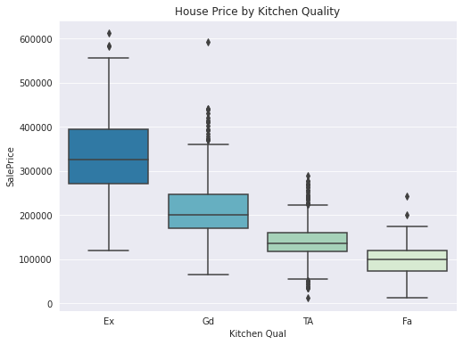
Kitchen Quality
The average price difference between a house with a good kitchen and one with an excellent kitchen is about $120,000.
Notes:
The last feature to explore is the kitchen quality. The difference in price between a property with a good kitchen and one with an excellent kitchen is almost $120,000 on average. As we can see from the plot, the price difference between residences with differing kitchen quality is significant. So when it comes to determining property price, kitchen quality is one of the most crucial factors. Next, I’ll hand the presentation over to Yu Kiat.

Slide 8
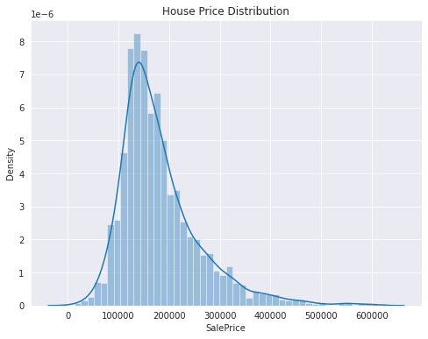
House price distribution
Most of the house prices are between 100,000 and 200,000.
The distribution of SalePrice is right-skewed. The right tail would be treated like outliers when modelling
Notes:
This graph shows the distribution of sale prices.
Most of the house prices are between 100,000 and 200,000.
The distribution of sale price is right-skewed. This means that most of the house prices are on the left side, and the values that are on the right side on the graph would be treated like outliers during the modelling.
We performed a log transformation to normalize the sale price distribution

Slide 9
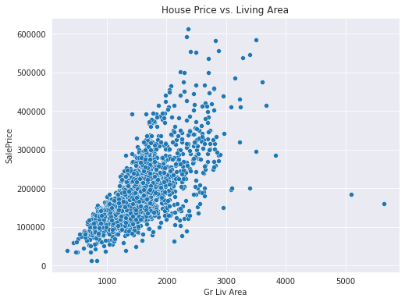
Dealing with Outliers
Regression models are sensitive to outliers, so they have to be removed.
The model may predict that houses with large above ground living area are cheaper if we do not remove the outliers
Notes:
Regression models are very sensitive to outliers so we have to remove them before training the model
As mentioned earlier, we found outliers in the "Above ground living area", and there are 2 data points where the area is more than 5000 square feet, but the sale price is below 200K. If we do not remove these outliers, the model may predict that houses with high above ground living area will be cheaper.

Slide 10
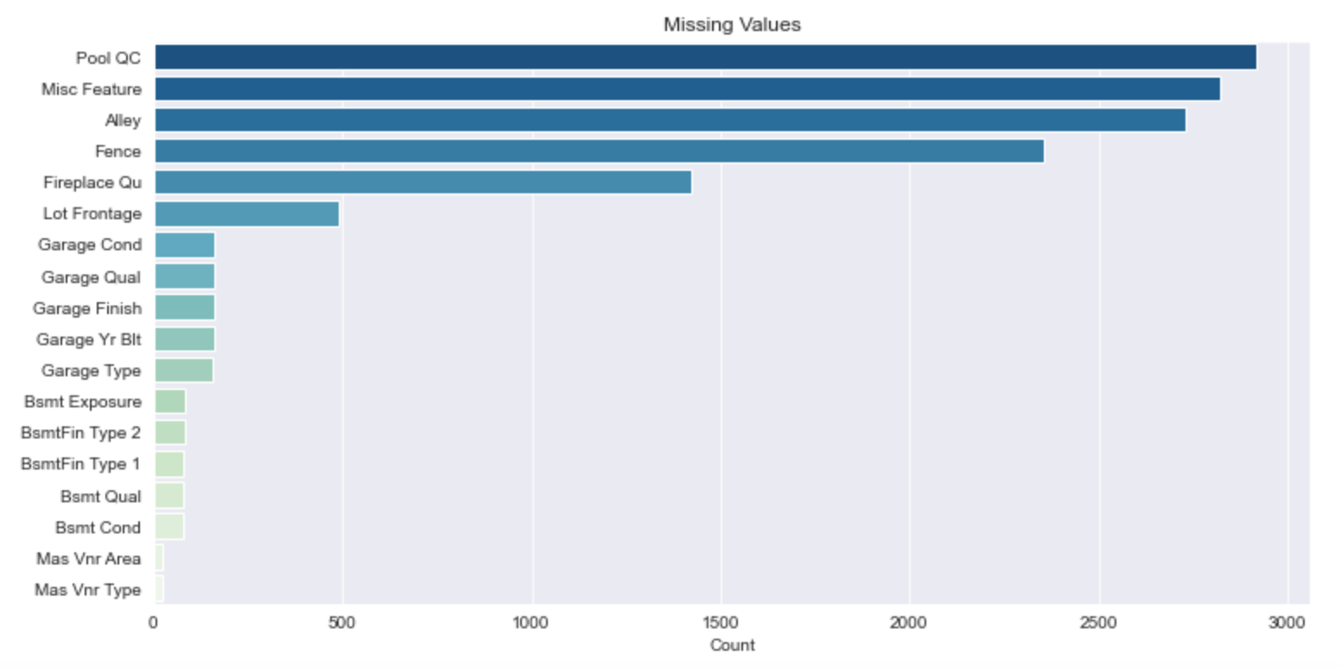
Missing Values
Category 1: Textual features where missing values mean a lack of the feature. Replaced with “None” Category 2: Numerical features related to Category 1 items. Replaced with 0 Category 3: Others Numerical: replaced with average Textual: replaced with most common value
Notes:
During our analysis we found missing values in the data set, and a few features had majority of its values missing. We grouped features with missing values into 3 categories.
Category 1: Textual features where missing values means the house does not have the feature. We replaced missing values with none
Category 2: Numerical features related to Category 1 features. Replaced missing values with 0
Category 3: Others. These are features that do not fall into Category 1 or 2. For numerical features, we replaced missing values with average and for textual features, we replaced missing values replaced with the most common value

Slide 11
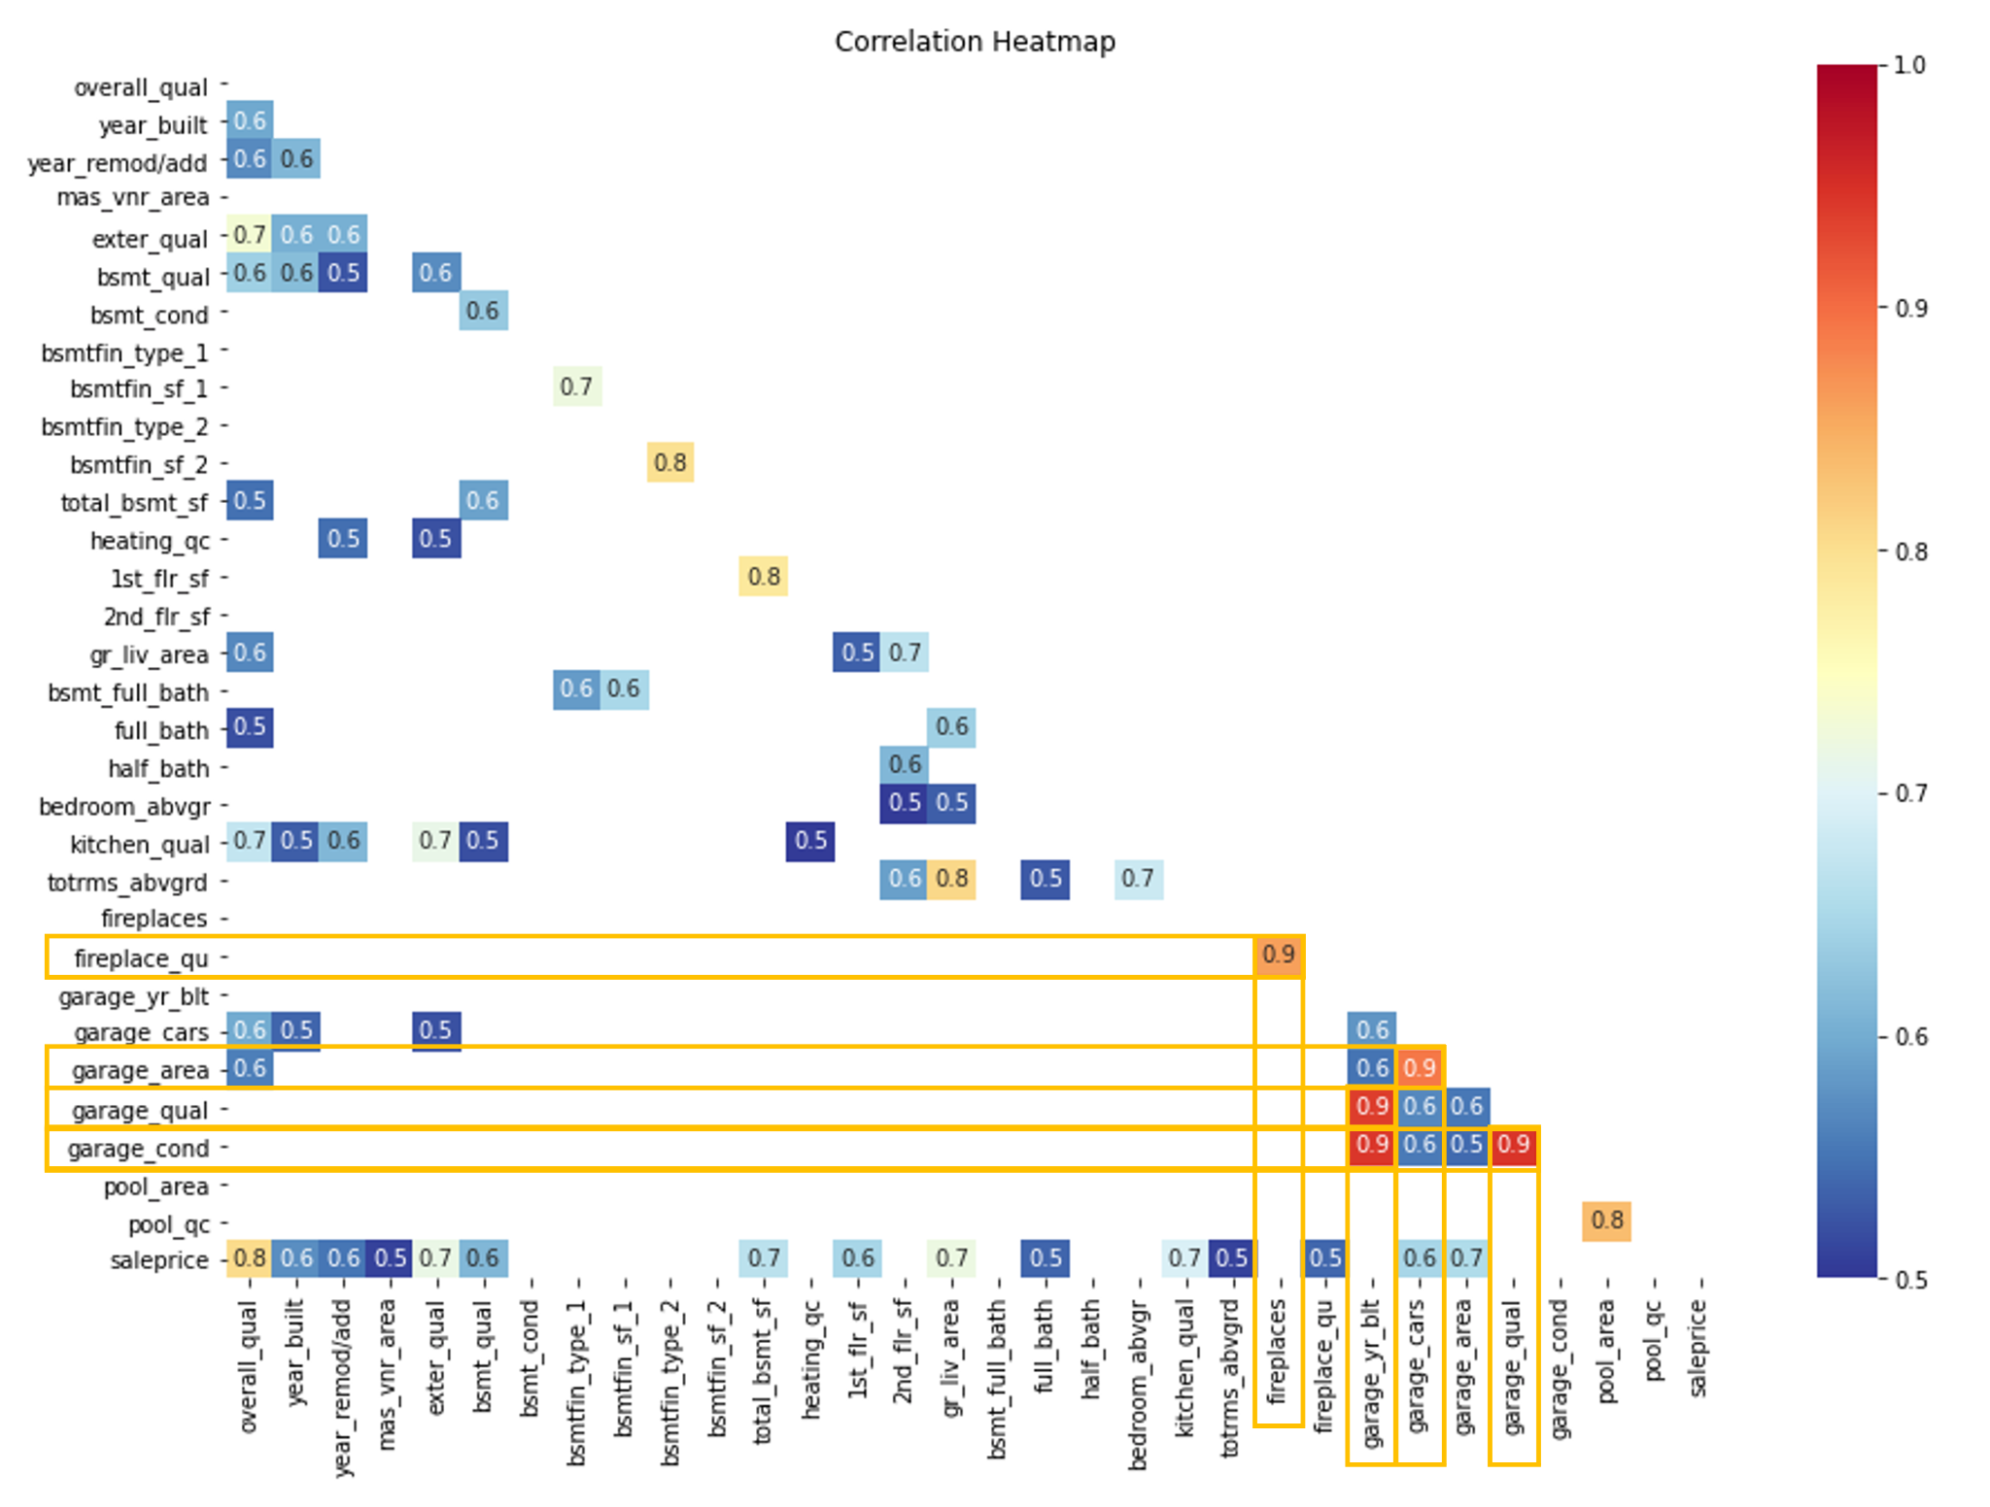
Multicollinearity
There are several highly linearly related features.
Independent features should be independent.
Reduces precision of coefficient estimates.
Notes:
Thank you Yu Kiat, next I will run through our feature engineering process. The correlation matrix shows many features having high correlation with other features. This can’t be helped as many features are often related to one another. Some highlighted pairs to note (as outlined in yellow boxes) are fireplaces and fireplace quality or garage cars and garage areas with very high correlation.
This brings about the problem of multicollinearity which means that our independent features are not independent. The good news is that it would not affect our model’s predictions on sale price but when we want to analyse the individual predictors and how their unit changes would increase or decrease the sale price, multicollinearity would reduce the precision of these coefficient estimates.

Slide 12

Feature Engineering
Combined features
E.g. Age, Size
New interaction features
E.g. Score = Quality x Condition or Quality x Quantity
The new features would produce multicollinearity but the modelling process would also help handle this issue.
Notes:
We tried to reduce this through engineering new features either by combining them e.g. to calculate the age or size of the house spaces.
At the same time, we also created new interaction features for our model to expand our understanding of the relationships among the features and its combined effect on sale price.
We tabulate the scores of certain features by multiplying the
quality * condition or quality * quantity.
By doing this, more collinear features are added hence we have to drop columns where necessary. The modelling process would also help to handle this issue.

Slide 13
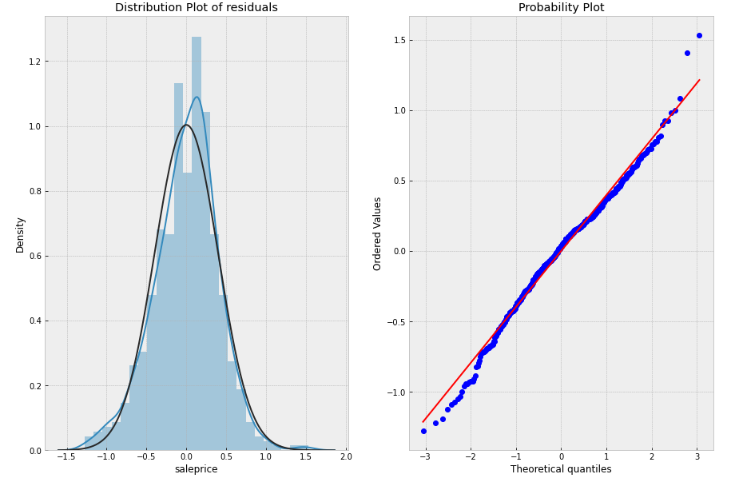
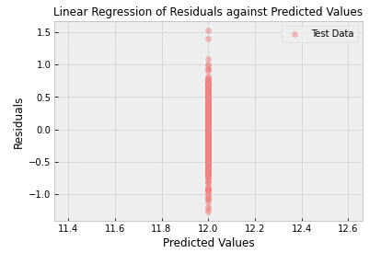
Baseline- mean
R² Score: 0
RMSE: $78,000
Notes:
We started the modelling process by splitting the dataset into a training file and a validation file in an approximately 70-30 split.
Using that we created a baseline model using average.
To determine model performance we used 2 metrics:
The first is R2 score, which is a measure of how well the model is able to explain changes in saleprice. Essentially speaking, the model is able to predict ~65 cents for a dollar change in saleprice.
secondly , we used RMSE which measures the mean difference between the true sales price and our predicted sale price
At a glance, the model performed decently on the training data but was not able to replicate it on the test data.
In the 1st chart we plotted the residuals against predicted prices and we can see that while training data in green looks randomly spread out, there seems to be a relationship between predicted values and residuals with the model undervaluing properties on the low end and over estimating properties on the higher end.
with negative residuals at lower predicted prices and positive residuals at higher predicted prices

Slide 14
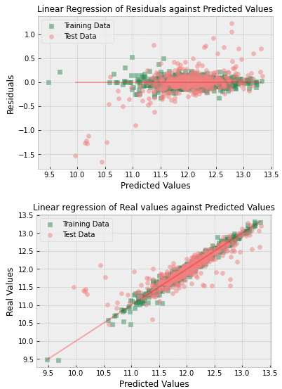
Model - Linear Regression
R² Score:
Train Score (Lr):
0.65
Test Score (Lr):
-20
RMSLE
Train Score (Lr):
44,670.20
Test Score (Lr):
$290,447.65
Notes:
Our second model was a basic linear regression model.
To determine model performance we used 2 metrics:
The first is R2 score, which is a measure of how well the model is able to explain changes in saleprice. Essentially speaking, the model is able to predict ~65 cents for a dollar change in saleprice.
secondly , we used RMSE which measures the mean difference between the true sales price and our predicted sale price
At a glance, the model performed decently on the training data but was not able to replicate it on the test data.
In the 1st chart we plotted the residuals against predicted prices and we can see that while training data in green looks randomly spread out, there seems to be a relationship between predicted values and residuals with the model undervaluing properties on the low end and over estimating properties on the higher end.
with negative residuals at lower predicted prices and positive residuals at higher predicted prices

Slide 15
Modelling - Performance Summary
Model | Train R2 | Test R2 | Train RMSE | Test RMSE
Linear Regression | 65.0% | -20.2% | 44670.20 | 290447.65
Ridge Regression | 92.0% | 91.1% | 20002.95 | 22804.35
Lasso Regression | 91.7% | 91.1% | 21107.78 | 23870.26
ElasticNet | 92.0% | 90.9% | 19988.28 | 22764.66
Notes:
Since the Linear regression did not meet our expectations, we built 3 additional regression models to predict the data: Ridge Lasso and ElasticNet. We have summarized the performance of the models in this slide.
The ElasticNet model performed the best of the 4 models and was able to explain about 91% of variance in sales prices on the test data and was able to make predictions within $22,000 of the actual sale price on the test data.

Slide 16
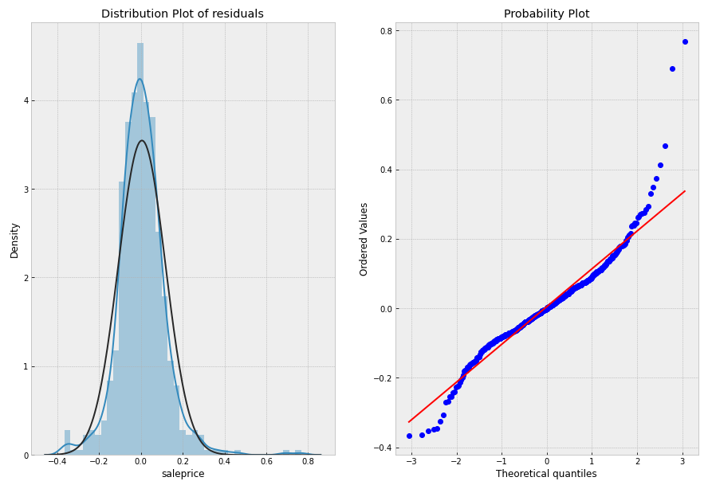
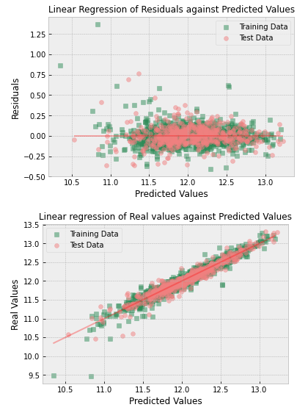
Model Performance - Distribution of residuals
Notes:
Here we plotted the residuals for our predictions. Ideally the residuals should follow a normal distribution indicating that there is no relationship between the size of the error and saleprice.
Here we have plot the distribution of residuals for the Lasso model appear mostly normal. I would like to highlight the probability plot in the center where we should see a straight diagonal line. However for this model we see the residuals deviate from the red line at both ends indicating that the residuals have a long tail distribution instead of a normal distribution
On the top left chart we can see that there are extreme outliers for 2 points which had a large residual size. Indicating that our model might have difficulty predicting houses that sold for less than 15K
These outliers could be the result of a feature that is not recorded in the dataset such as related party transactions.

Slide 17
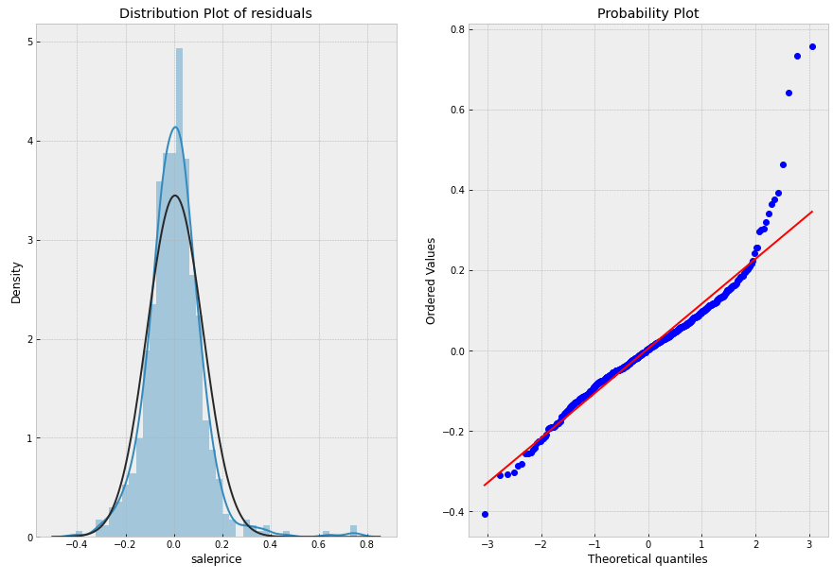
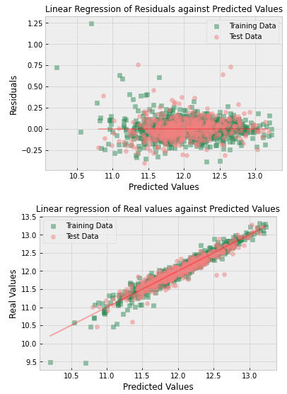
Model Selection - ElasticNet
Notes:
On the probability plot for the ElasticNet model we can see that the residuals are more normally distributed than before but we can see that some outliers are still present.

Slide 18
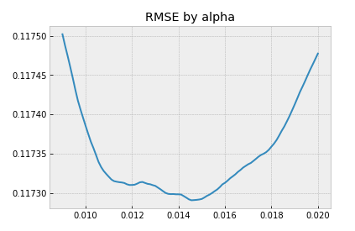
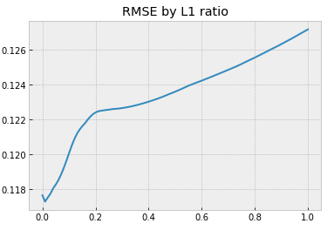
Model Tuning for RMSLE
Optimal Alpha:
0.015
Optimal L1 ratio:
0.01
Notes:
Once we selected our model we tuned our hyperparameters to obtain the best possible RMSLE.
Here we have plotted RMSLE by various alphas/l1 ratios finally arriving at an alpha of 0.015 and l1 ratio 0.01

Slide 19
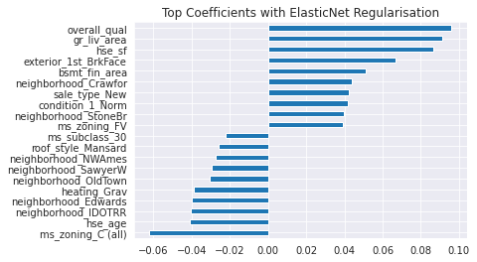
Modelling - Features with Largest Coefficients
Notes:
Here we have prepared a bar graph of the features with the highest absolute regression coefficients , that general describes the size and direction of the relationship between the features and salesprice.
Broadly speaking we observe that there is a mix of features describing quality, condition, living area, neighbourhood and zoning and aesthetic features have a notable impact on housing prices.
More importantly we can separate the features into 2 buckets and employ different strategies to mitigate the effect of negative variables while leveraging on features that have a positive impact to increase potential sale price. Where features that can be altered like heating or
##For example:
Bsmt Fin Area - where a 10% increase in finished area would result in an 1.1^(0.05) = 0.4% increase in sale price
Roof style - where removing masard roofs is expected to increase sale price by 3.04% (exp 0.03)
at various stages of our business process.
For factors outside our control such as neighbourhoods or zoning laws:
Bidding stage:
Several neighbourhoods show up here and by rejecting applicants from certain neighbourhoods or increasing fees for these neighbourhoods profit margins can be maintained. (Charging a 4% higher fee for properties in IDOTRR (exp(0.04))
Houses in ms zoning area C (all) also has a negative impact on sale price and should be avoided.
For factors that we can change, we are left with the following features:
Repair/modification stage:
Bsmt Fin Area - where a 10% increase in finished area would result in an 1.1^(0.05) = 0.4% increase in sale price
Roof style - where changing it would increase sale price by 3.04% (exp 0.03)
Heating - swapping out gravity furnaces improves sale price by 4% (exp 0.04)
Hse sf/gr_liv_area - 10% increase results in 0.8% increase in sale price
Hse_age

Slide 20
Recommendation
Avoid certain neighbourhoods
Focus on aesthetic features that carry a premium
Brick exterior
Next steps:
We would require a companion analysis on labour and material costs on a case by case basis to predict profitability of the renovations.
Notes:
Now that we have found out what are the key factors that influence the sale price.
We can avoid certain neighbour areas or zoning as they show a negative impact on sale price and it should be avoided.
Additionally, we can focus on aesthetic features that carry a premium price. For example, roof style - where removing masard roofs is expected to increase sale price by 3.04% (exp 0.03)
Our next steps would be to create a companion analysis on labor and material cost to provide estimated cost of various modifications that we can combine with this model to predict profitability of renovations.

Slide 21
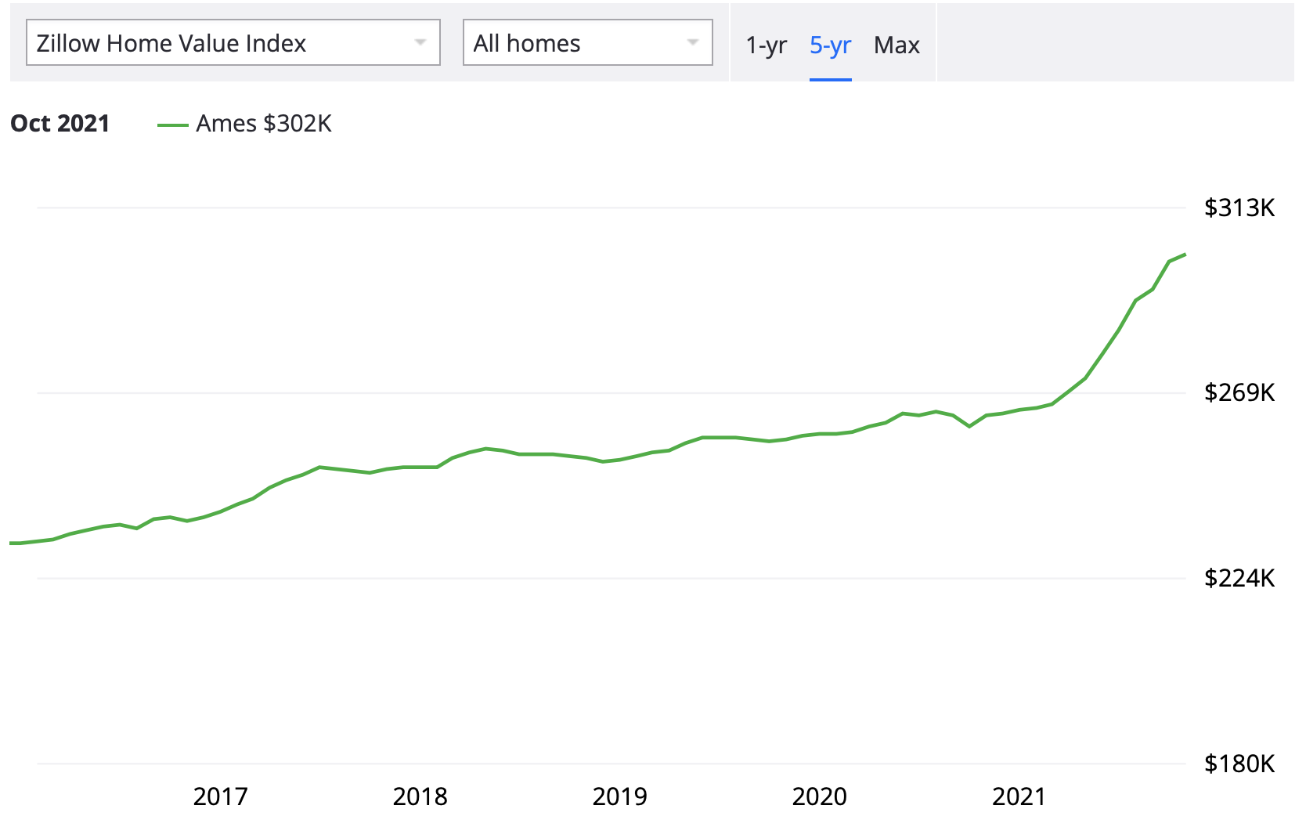
External factors
Source: https://www.zillow.com/ames-ia/home-values/
Notes:
However, external factors could affect our model predictions.
As all of us are aware that covid19 happened in the year 2019, this covid 19 is an external factor and a black swan event that could affect the model prediction.
From the chart itself, it shows that there is a steep increase in home value from $252,000 to $281,000 from December 2020 to December 2021. That’s a 11.5% increase in just a year. Generally, the properties in Ames Market increase only by 4.3% on average annually.
Residential architecture trends also fluctuate across the years and more data collection is needed to fine tune our model for these changes.
https://www.cnbc.com/2021/09/03/asia-pacific-property-bidding-wars-cash-offers-drive-up-home-prices.html

Slide 22

Conclusion
ElasticNet model performed the best due to the normality of the distribution
Recommend frequently recording housing specs and sales price
Notes:
Among the 4 models, the ElasticNet model performed the best and was able to explain about 92% of variance in sales prices on the train data and produced the lowest RMSE of 0.116 on both the train and test data. Hence, our team recommends ElasticNet model to predict the sale price due to the normality of distribution.
However, since we used the 2006 to 2010 dataset to build the model and the real estate market is constantly changing, our best model might not fit the current market. Going forward, we would recommend frequently recording housing specs and sales prices in the Ames area and maintaining a database with the relevant information to continually improve on the model’s ability to predict sales price, even in the face of an ever-changing market landscape.

Slide 23
Q&A

Slide 24
Annex - Missing Values
Split columns with missing/null values into 2 groups:
Categorical values where NA means no feature:
Pool QC, Misc Feature, Alley, Fence, Fireplace Qu, Garage Type, Garage Finish, Garage Qual, Garage Cond, Bsmt Qual, Bsmt Cond, Bsmt Exposure, BsmtFin Type 1, BsmtFin Type 2, Mas Vnr Type
Imputed with “None”
Numerical values where NA means no feature:
Garage Area, Garage Cars, BsmtFin SF 1, BsmtFin SF 2, Bsmt Unf SF, Total Bsmt SF, Bsmt Full Bath, Bsmt Half Bath, Mas Vnr Area
Imputed with 0
Others:
Lot Frontage
Imputed with the mean
Garage Yr Built
Imputed with Year Built
Functional, MS Zoning, Electrical, Kitchen Qual, Exterior 1, Exterior 2, Sale Type, Utilities
Imputed with the mode

Slide 25
Annex - Engineering New Features
Total square feet
Adding all the square feet of the floors
TotalBsmtSF + 1stFlrSF + 2ndFlrSF
Total bathrooms
Adding together the number of bathrooms
FullBath + BsmtFullBath + 0.5(HalfBath + BsmtHalfBath
Age of house
Number of years between built and sold
Yr Sold - Year Built
Remodeled or not?
Whether the house was remodelled
If Year Remod/Add = Year Built, 0 (i.e. False)
Else, 1 (i.e True)
New or not?
Whether the house is new
If Yr Sold = Year Built, 1 (i.e. True)
Else, 0 (i.e. False)

Slide 26
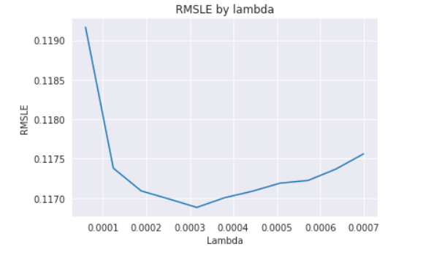
Plug and play for lambda/alpha
Notes:
ylabel change to Prediction Error (RMSLE), xlabel change to Regularisation Rate (Lambda)?

